Slide 1

PROBABILISTIC GRAPHICAL MODEL
SESSION # 1 : INTRODUCTION
SEETHA PARAMESWARAN
seetha.p@pilani.bits-pilani.ac.in

Slide 2
The instructor is gratefully acknowledging the authors who made their course materials freely available online.
Probabilistic Graphical Model

Slide 3



Table of Contents
Uncertainty
1
Probabilistic Graphical Model
2
Applications of Probabilistic Graphical Model
3
Course Logistics
4
Probabilistic Graphical Model

Slide 4
Uncertainty
We select a course of actions among many possibilities.
Decisions may be based on the information obtained from the environment, previous knowledge and the objectives.
Eg: It looks cloudy. Should I carry an umbrella?
The information and knowledge is incomplete or unreliable. So the decisions made are not certain. We make decisions under uncertainty.
One of the goals of AI is to develop systems that can reason and make decisions under uncertainty.
Probabilistic Graphical Model

Slide 5
Uncertainty
Complexity increases
Each piece of knowledge may not be independently used to arrive at decisions.
Deduced facts are maintained along with new facts. This increases the knowledge base.
Examples
A medical doctor in an emergency.
An autonomous vehicle that detects what might be an obstacle in its way.
A financial agent needs to select the best investment.
Probabilistic Graphical Model

Slide 6
Limitations of Traditional Approach
Impractical for complex problems with many variables, as the size of the Joint probability table and the direct computation of Marginal and Conditional probabilities grow exponentially with the number of variables in the model.
Good estimates for the joint probabilities from data requires a very large database if there are many variables in the model.
Probabilistic Graphical Model

Slide 7

Table of Contents
Uncertainty
1
Probabilistic Graphical Model
2
Applications of Probabilistic Graphical Model
3
Course Logistics
4
Probabilistic Graphical Model

Slide 8
Probabilistic Graphical Models
Provide a framework for managing uncertainty based on probability theory in a computationally efficient way.
Consider Independence relations that are valid for a certain problem, and use independence to reduce computational complexity and be memory efficient.
Represent the dependence and independence relations between a set of variables using graphs.
Probabilistic Graphical Model

Slide 9
Probabilistic Graphical Models
Around 2000s
Techniques based on probability and graphical representations were consolidated as powerful methods for representing, reasoning and making decisions under uncertainty.
Bayesian networks, Markov networks, influence diagrams and Markov decision processes, among others.
Probabilistic Graphical Model

Slide 10


Probabilistic Graphical Model
Probabilistic Graphical Model combines probability theory and graph theory to deal with problems involving uncertainty and complexity and also in the design and analysis of machine learning algorithms.
Probabilistic Graphical Model
Graph
Probability
Probabilistic Graphical Model

Slide 12
Need of Probabilistic Graphical Model
Model uncertainty.
Model complex structures with causal and spatial relationships. Model domain knowledge and prior knowledge.
Draw inferences from the model.
Learn the structure and parameters of the model.
Probabilistic Graphical Model

Slide 13
Classification of Probabilistic Graphical Model
Direct or Undirected
Directed graphs represent parent-child relations or cause-effect relations.
Undirected graphs represent symmetric relations.
Static or Dynamic
Static – Model represents a set of variables at a certain point in time.
Dynamic – Model represents a set of variables across different times.
Probabilistic or Decisional
Probabilistic models include random variables.
Decisional models include random variables, decision and utility variables.
1
2
3
Probabilistic Graphical Model

Slide 14
Common Probabilistic Graphical Models
Type | Directed / Undirected | Static / Dynamic | Probabilistic / Decisional
Bayesian Models | both | Static | Probabilistic
Markov Chains | Directed | Dynamic | Probabilistic
Hidden Markov Models | Directed | Dynamic | Probabilistic
Markov Random Fields | Undirected | Static | Probabilistic
Bayesian Networks | Directed | Static | Probabilistic
Dynamic Bayesian Networks | Directed | Dynamic | Probabilistic
Influence Diagrams | Directed | Static | Decisional
Markov Decision Processes | Directed | Dynamic | Decisional
Partially Observable MDPs | Directed | Dynamic | Decisional
L E Sucar
Probabilistic Graphical Model

Slide 15
Table of Contents
Uncertainty
1
Probabilistic Graphical Model
2
Applications of Probabilistic Graphical Model
3
Course Logistics
4
Probabilistic Graphical Model

Slide 16
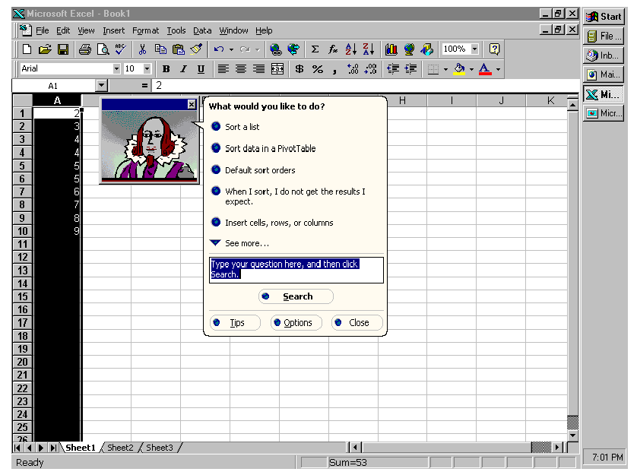
Bayesian Models -Microsoft Lumiere Project
http://erichorvitz.com/lumiere.htm
Probabilistic Graphical Model

Slide 17
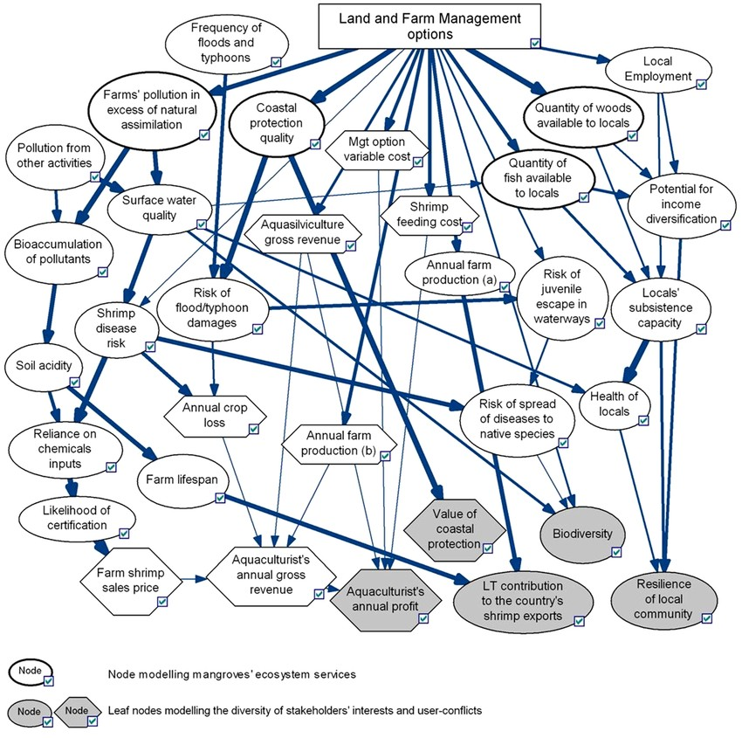
Bayesian Models – Life Sciences
Schmitt, Laetitia & Brugere, Cecile. (2013). Capturing Ecosystem Services, Stakeholders’ Preferences and Trade-Offs in Coastal Aquaculture Decisions: A Bayesian Belief Network Application.
Probabilistic Graphical Model

Slide 18
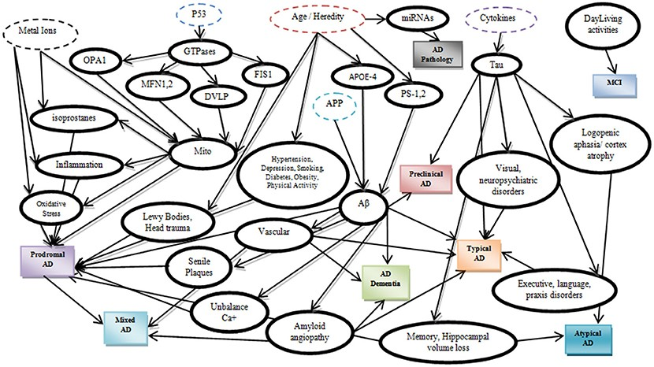
Bayesian Models – Medical Diagnosis
https://doi.org/10.3389/fnagi.2017.00077
Probabilistic Graphical Model

Slide 19
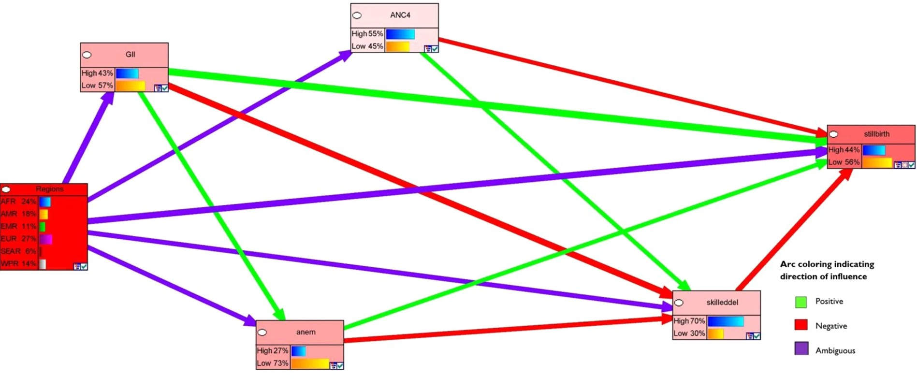
Bayesian Models – Spatial
Relationship
https://www.ncbi.nlm.nih.gov/pmc/articles/PMC6930217/
Probabilistic Graphical Model

Slide 20
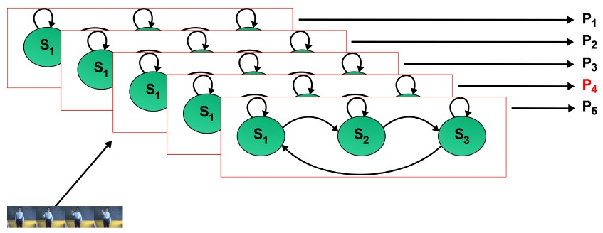
Hidden Markov Model – Gesture Recognition
L E Sucar
Probabilistic Graphical Model

Slide 21
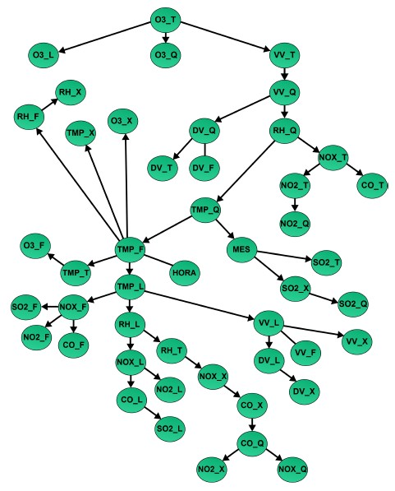
Bayesian Networks – Ozone Prediction
L E Sucar
Probabilistic Graphical Model

Slide 22
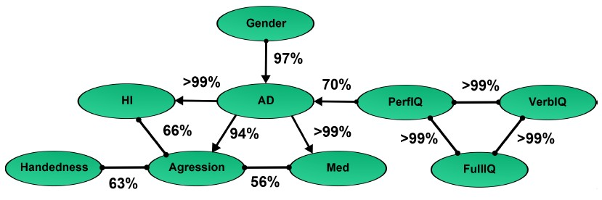
Bayesian Networks – Attention Deficit Model
L E Sucar
Probabilistic Graphical Model

Slide 32
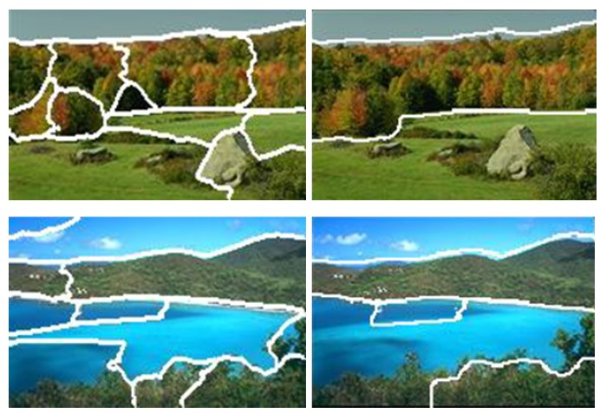
Markov Random Fields – Image Segmentation
L E Sucar
Probabilistic Graphical Model

Slide 33
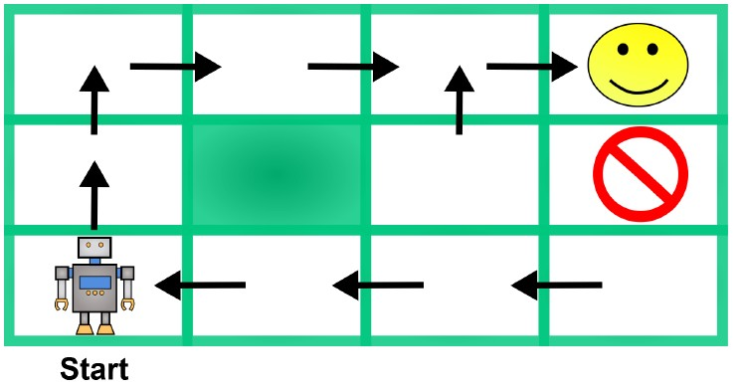
Markov Decision Process – Robot Motion Planning
L E Sucar
Probabilistic Graphical Model

Slide 34
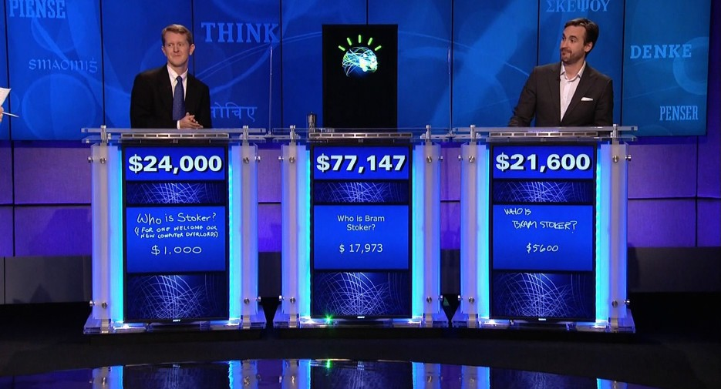
Use Cases of PGM – Question Answer
D Sontag
Probabilistic Graphical Model

Slide 35
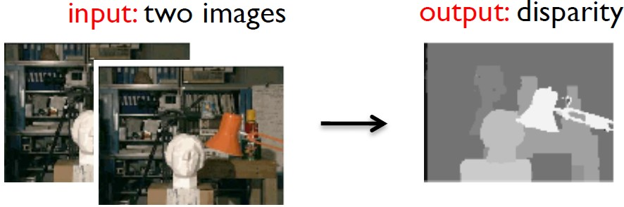
Use Cases of PGM – Stereo Vision
D Sontag
Probabilistic Graphical Model

Slide 36

Google Translation
Knowledge and Language Graph
Probabilistic Graphical Model

Slide 37
Table of Contents
Uncertainty
1
Probabilistic Graphical Model
2
Applications of Probabilistic Graphical Model
3
Course Logistics
4
Probabilistic Graphical Model

Slide 38









Components of Probabilistic Graphical Model
Directed / Bayesian
Structure Learning
Represent ation
Learning
Probabilistic Graphical Model
Undirected
/ Markov
Parameter Estimation
Inference
Exact Inference
Approximate Inference
Probabilistic Graphical Model

Slide 39
Course Handout
M1 Introduction
M2 Mathematical Preliminaries M3 Directed Graphical Models M4 Undirected Graphical Models M5 Exact Inference
M6 Approximate Inference M7 Parameter Learning M8 Structure Learning M9 Models
Probabilistic Graphical Model

Slide 40
Lab Sessions
Python
pgmpy Library
1
2
L1 Bayesian model representation L2 Markov Model representation L3 MAP on Bayesian model
L4 MLE on Bayesian Model
L5 MLE on Markov Model
L6 Learning Structure in Bayesian Model
Details will be posted in Canvas.
Probabilistic Graphical Model

Slide 41
Evaluation Components
Component | Weightage
Assignments | 20 %
Quiz | 10 %
Mid Sem | 30 %
Compre | 40 %
Further announcements will be posted in Canvas.
Probabilistic Graphical Model

Slide 42
References
1
Probabilistic Graphical Models: Principles and Techniques by Daphne Koller and Nir Friedman. MIT Press. 2009
2
Mastering Probabilistic Graphical Models using Python by Ankur Ankan, Abhinash Panda. Packt Publishing 2015.
3
Learning in Graphical Models by Michael I. Jordan. MIT Press. 1999
Thank You !!!
Probabilistic Graphical Model

